Slide 1
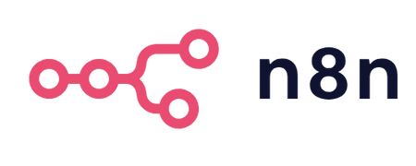
Onboarding Product Teardown
Dipak Nandeshwar

Slide 2
$23.77B workflow automation market
What is
Primary Competitors
n8n is a workflow automation platform that uniquely combines AI capabilities with business process automation, giving technical teams the flexibility of code with the speed of no-code.
n8n (pronounced "n-eight-n"): A fair-code licensed, extendable workflow automation tool.
Business Model: Open-source with paid cloud and enterprise offerings.
Market: Competes with Zapier, Make, and Pipedream.
Value Prop: Enables technical users to automate workflows without vendor lock-in.
Zapier - The Market Leader
Make (formerly Integromat) - The Visual Alternative
Microsoft Power Automate - Enterprise Integration
Pipedream - Developer Platform
Competitive Advantages
Cost Efficiency: Better economics for high-volume, complex workflows
Technical Flexibility: Unlimited customization potential
Data Sovereignty: Self-hosted deployment for security/compliance
Developer Experience: Node-based approach familiar to technical users
Community-Driven: Open development model with community contributions
Market & Business Context
AI-augmented workflow automation has exploded as firms race to connect SaaS, LLMs, and internal data. n8n competes against Zapier, Make, Pipedream, and Relay in the “developer-friendly, self-hostable” niche.
230 k + active users; 70 k + GitHub stars by mid-2025.
40% YoY user growth after releasing AI Agent nodes.
Revenue via freemium cloud (Starter $20/mo, Pro $50/mo), plus paid self-host licences for SSO/RBAC.

Slide 3


Primary persona: Automation-savvy engineer
User Personas
Arjun - Senior DevOps Engineer,
29 years old, Bangalore, Karnataka
Needs
Priya - Operations Manager
27 years old, Mumbai, Maharashtra
Affordable Pricing: Solutions that work within Indian startup budgets
Needs
Self-Hosting Options: Eliminate recurring cloud costs and ensure data control
Open Source: Community-driven solutions with transparent development
Logistic integration: Solution that helps with integration solutions
Pain Points
Expensive enterprise tools
Integration with legacy systems
Pain Points
Manual processes resulting in issues
Multi-language customer communication

Slide 4
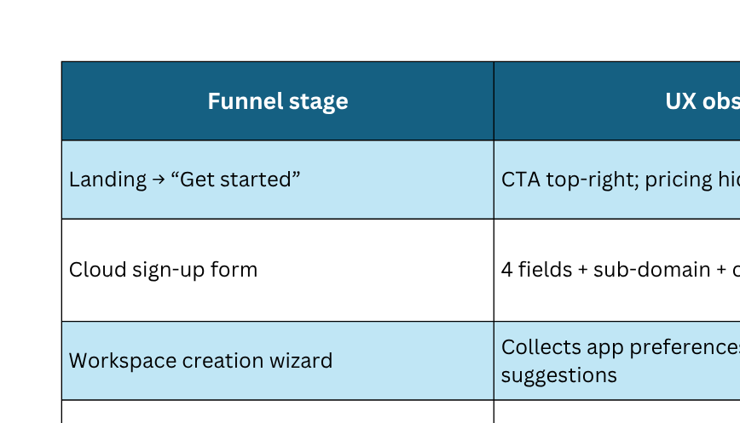
User-Journey Mapping

Slide 5
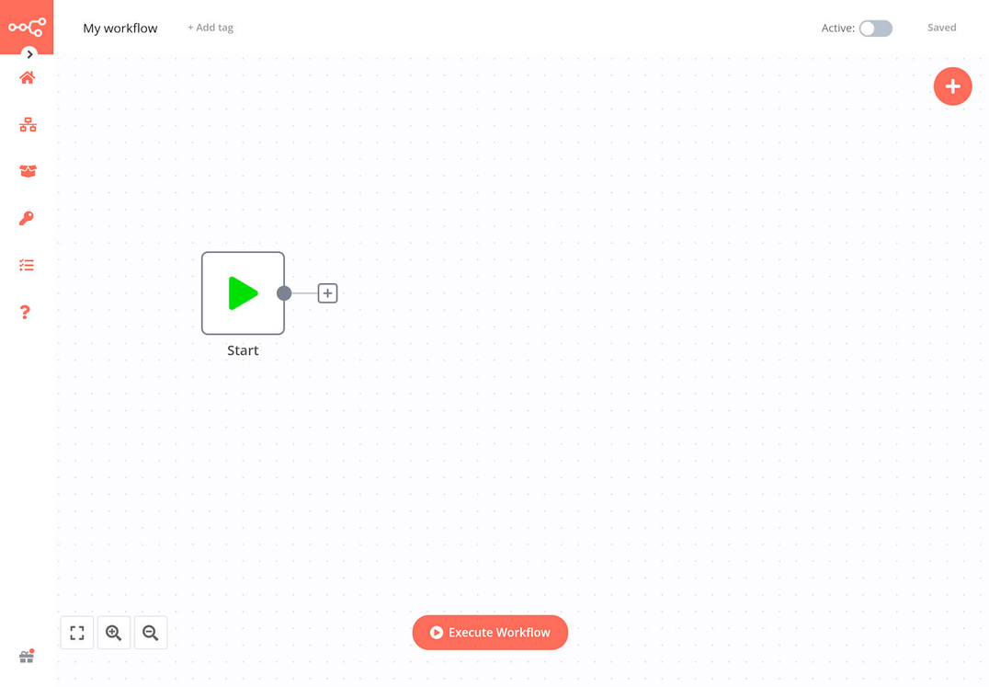
Pain Points the Onboarding Flow Solves
Data control anxiety – early messaging on self-host & fair-code license.
LLM curiosity – AI Agent templates surfaced at onboarding.
Cost fear – execution-based pricing explanation during sign-up.
Friction & Gaps
Cognitive overload: node list lacks tier-1 quick-starts; Reddit threads cite “700 nodes conspiracy board” overwhelm.
Sparse inline guidance: only initial tooltip tour; advanced concepts (item vs. list, run-once testing) push users to docs/forums.
Debug opacity: new users struggle with error traces in sub-workflows; early failures correlate with 22% higher churn.
No sandbox template autoload: competitors preload a working demo (Zapier, Relay).

Slide 6
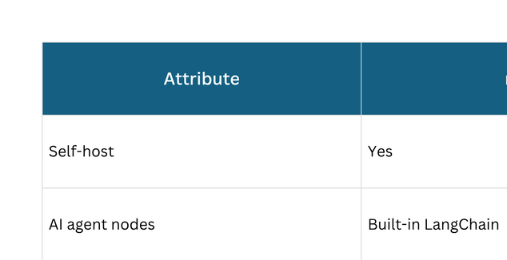
Competitive Comparisons
As AI agents mature, onboarding must pivot from “connect apps” to “deploy an autonomous co-worker.” Expect:
Natural-language flow creation (prototype in roadmap survey).
Pre-vetted security blueprints to counter enterprise compliance pushback.
Marketplace-style installation of verticalised onboarding packs (HR, RevOps) bundling nodes + docs.

Slide 7
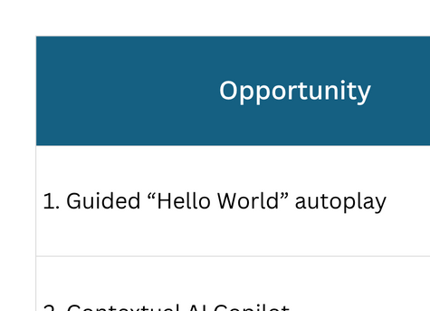
Strategic Recommendations

Slide 8
Metrics: User adoption journey for n8n
Awareness
Acquisition
Activation
Website traffic (unique visits, referrals)
Source attribution (Reddit, YouTube, GitHub, newsletters)
Ad impressions and click-through rate (CTR)
Developer community mentions (e.g., GitHub stars, Reddit threads)
Signup rate (visits → signup/download)
Drop-off rate on key pages (landing → docs → download)
Time to first meaningful action (TTFMA) – e.g., creating a workflow
Conversion rate from documentation/tutorials
First workflow completion rate
Nodes used in the first workflow
Time to first successful run
Error rate during initial setup
Activation funnel completion (setup → build → run)
Engagement
Retention
Expansion
Weekly Active Users (WAU) / Monthly Active Users (MAU)
Number of workflows created per user
Number of active workflows (executed in last 7 days)
Node diversity (types of integrations used)
Workflow execution frequency
Day 7, Day 30 retention
Workflow edits over time
Recurrent workflow execution rate
Notification/email alert engagement (if configured)
Churn rate
Upgrade conversion rate (cloud → team/self-host)
Invitations sent (if team features used)
Plugin/custom node usage (depth of adoption)
API usage volume
Workspace collaboration events

Slide 9
Thank You

